Slide 1
Inventory Strategy (hierarchical)
Level | Detail | Key question | Ice masses | Required studies | Methods
1 | Low | How many glaciers are in Argentina and how large are they? | All ice bodies of hydrological significance | Counting, area determination, and morphometric parameters of the different ice bodies | Generation of digital elevation models, watershed determination, identification and mapping based on satellite images. Field control.
2 | Medium | How does the size and dynamics of glaciers changed in recent years? | One or two ice bodies by basin | Fluctuations in area, length and speed of movement in recent years/decades | Analysis of aerial photographs and satellite imagery, historical sources, complemented by field work
3 | High | What physical parameters control glacier behavior? What volume of water is storage in the ice? What is the contribution of ice to runoff? | A representative glacier per region | Combination of mass, energy, and hydrological balances. Precise surface topography, monitoring of active layer thickness, estimated volume of ice. | Network of metric-poles, installation of nivo-meteorological stations and flowmeters, GPS surveying, photogrammetry and aerial measurements of thickness with ground penetration radar.

Slide 2
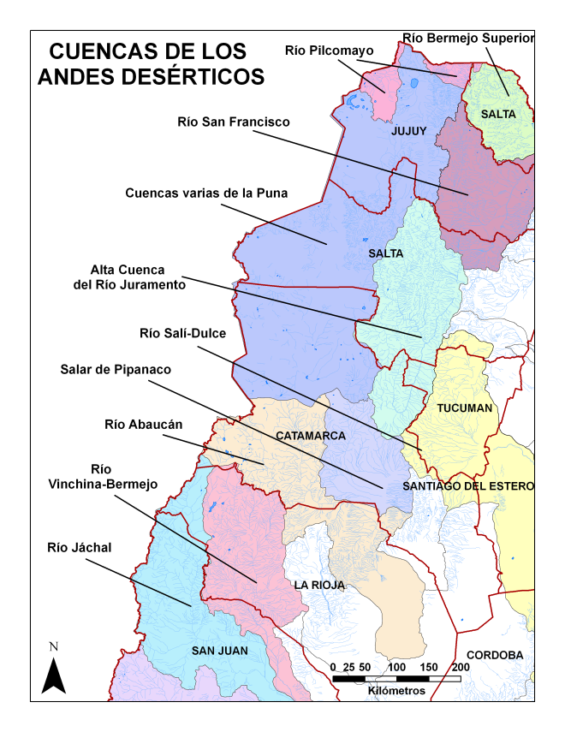
Geographical organization of the National Inventory
Due to the large size of the area to survey, and the wide range of diverse glacial and periglacial environments across the Andes, the national inventory was organized in five major regions:
Andes Desérticos
Andes Centrales
Andes del Norte de la Patagonia
Andes del Sur de la Patagonia
Andes de Tierra del Fuego
e islas del Atlántico Sur

Slide 3
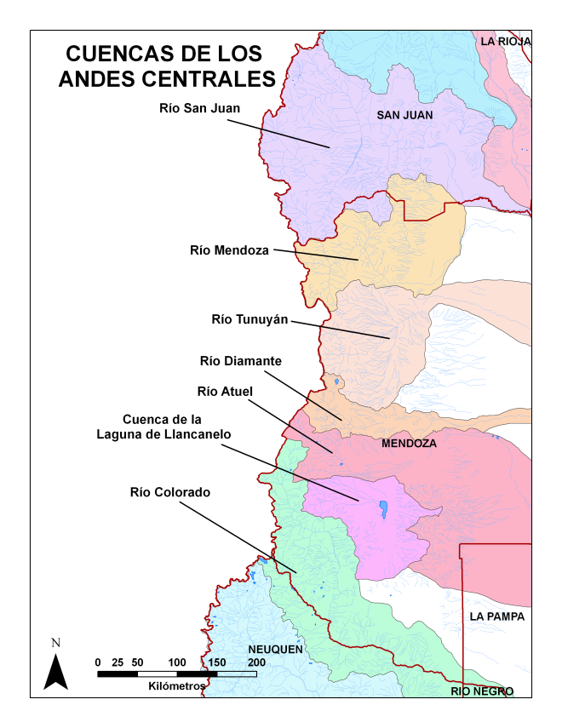
Geographical organization of the National Inventory
Due to the large size of the area to survey, and the wide range of diverse glacial and periglacial environments across the Andes, the national inventory will be organized in five major regions:
Andes Desérticos
Andes Centrales
Andes del Norte de la Patagonia
Andes del Sur de la Patagonia
Andes de Tierra del Fuego
e islas del Atlántico Sur

Slide 4
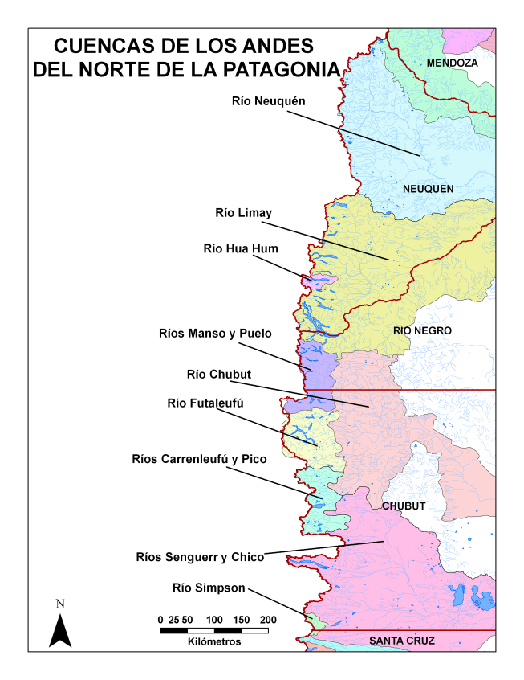
Geographical organization of the National Inventory
Due to the large size of the area to survey, and the wide range of diverse glacial and periglacial environments across the Andes, the national inventory will be organized in five major regions:
Andes Desérticos
Andes Centrales
Andes del Norte de la Patagonia
Andes del Sur de la Patagonia
Andes de Tierra del Fuego
e islas del Atlántico Sur

Slide 5
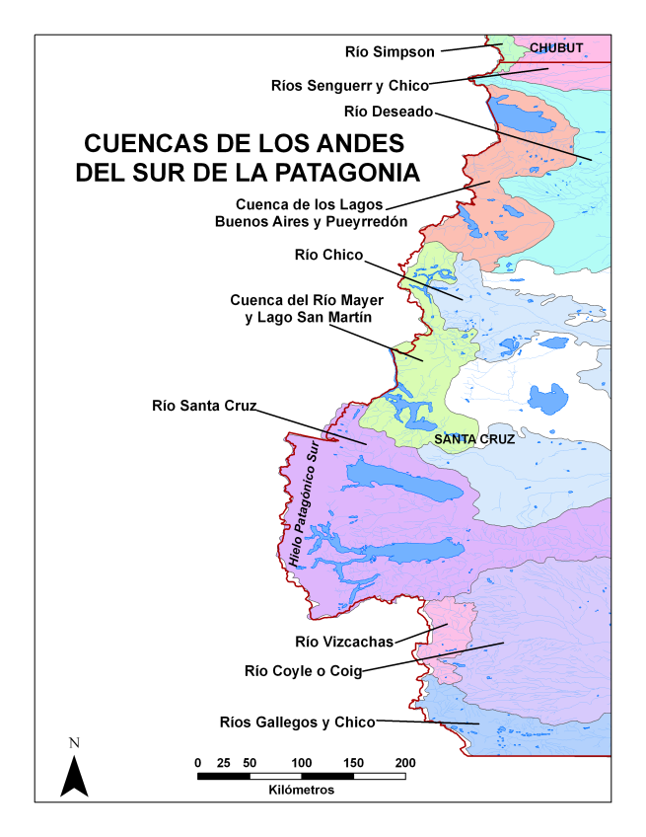
Geographical organization of the National Inventory
Due to the large size of the area to survey, and the wide range of diverse glacial and periglacial environments across the Andes, the national inventory will be organized in five major regions:
Andes Desérticos
Andes Centrales
Andes del Norte de la Patagonia
Andes del Sur de la Patagonia
Andes de Tierra del Fuego
e islas del Atlántico Sur

Slide 6
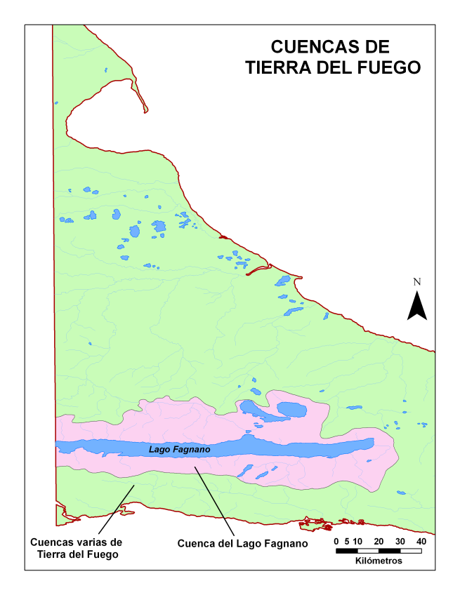
Geographical organization of the National Inventory
Due to the large size of the area to survey, and the wide range of diverse glacial and periglacial environments across the Andes, the national inventory will be organized in five major regions:
Andes Desérticos
Andes Centrales
Andes del Norte de la Patagonia
Andes del Sur de la Patagonia
Andes de Tierra del Fuego
e islas del Atlántico Sur

Slide 7
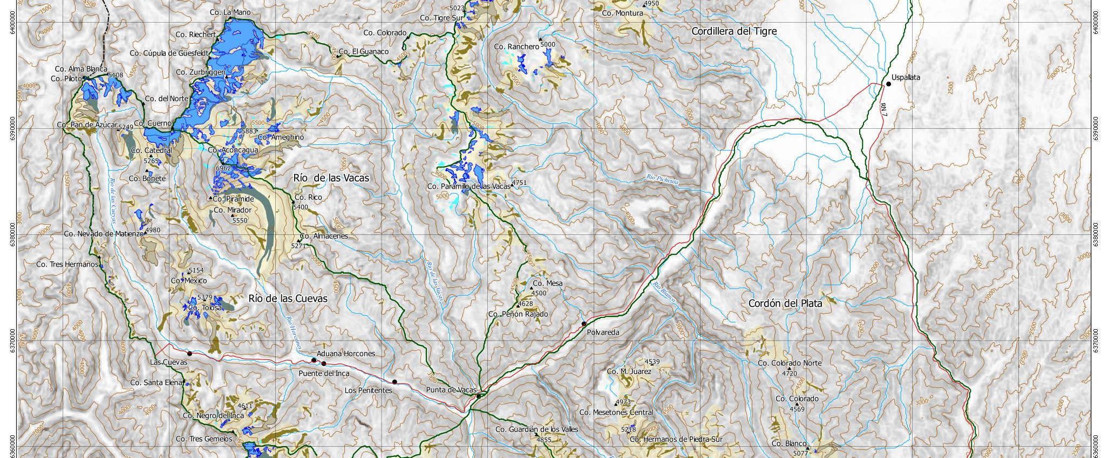
Inventario de Glaciares
y Ambiente Periglacial
1. Río Mendoza

Slide 9
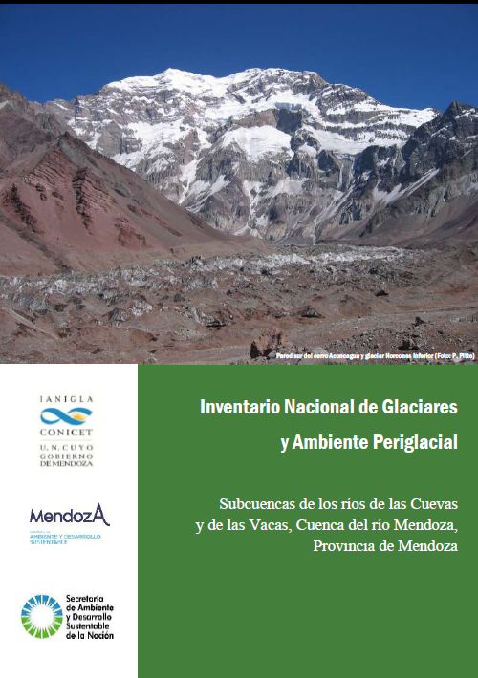

Slide 10
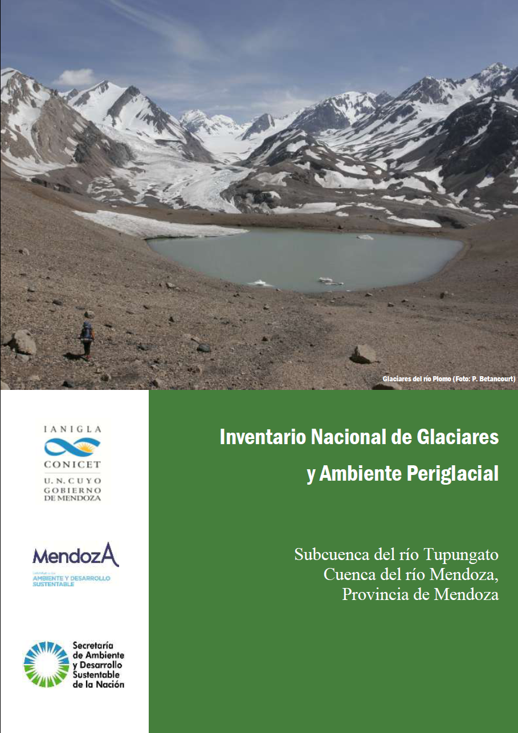
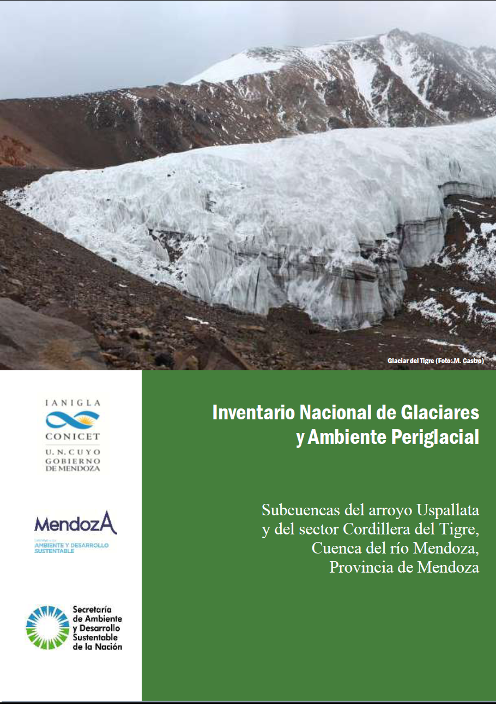
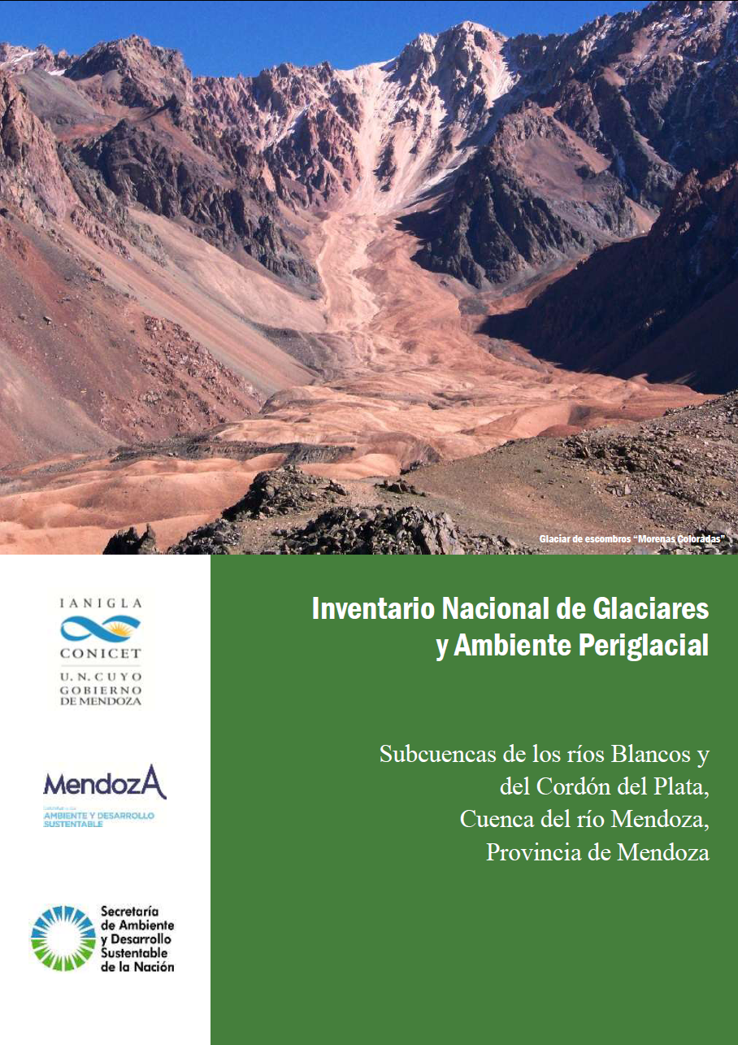

Slide 11
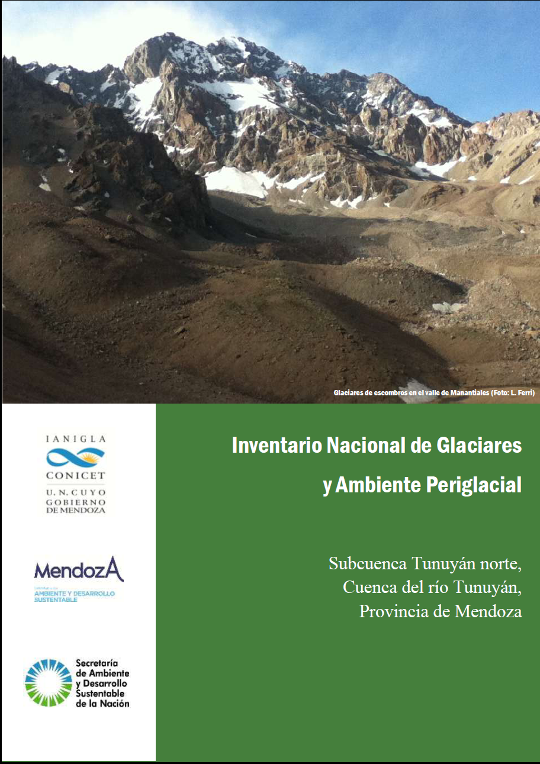
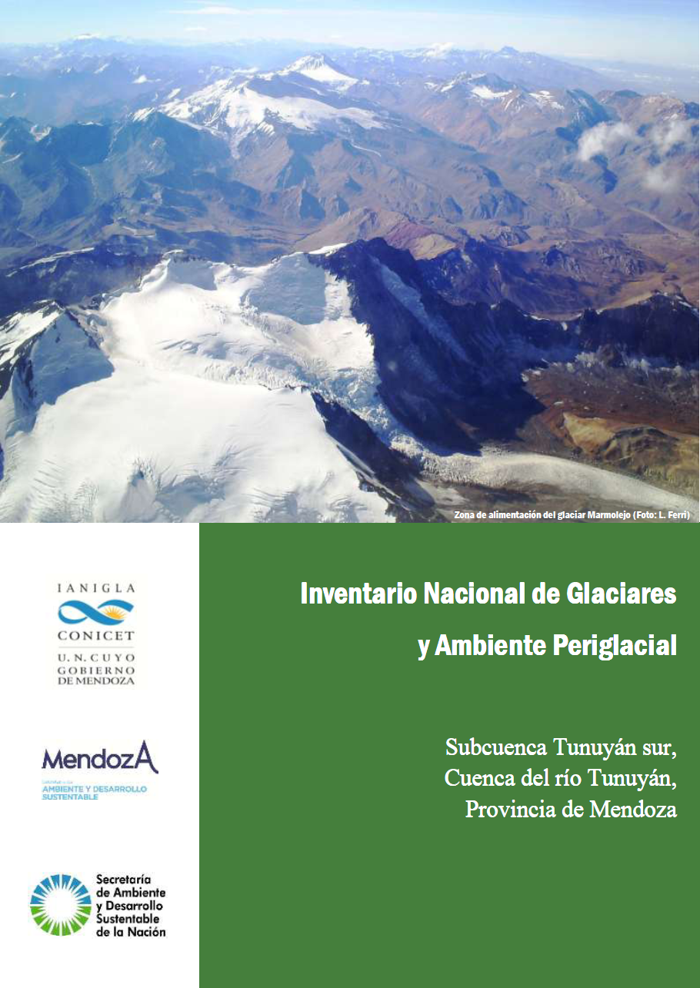

Slide 12
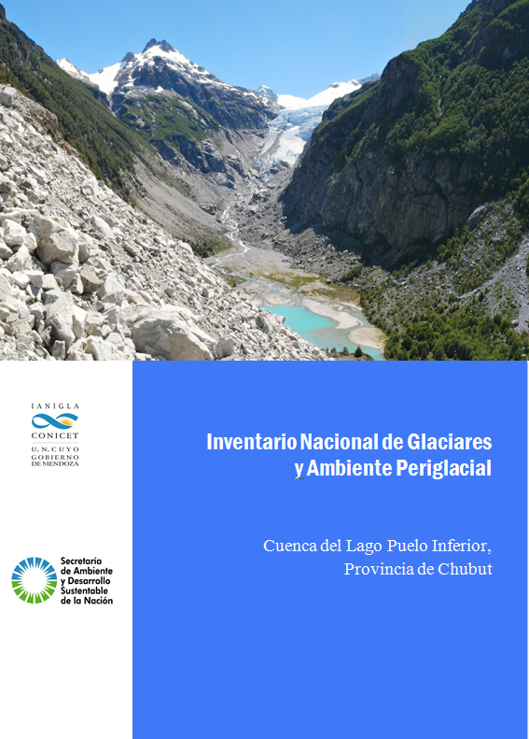

Slide 13
